Slide 1

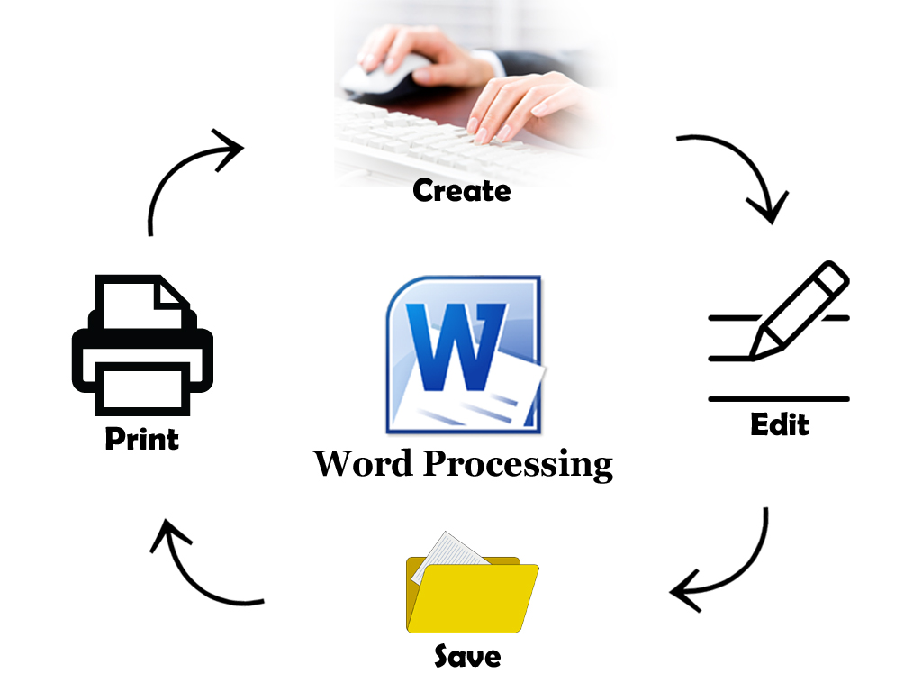


Word
Processing
Class V
lab 16

Slide 2

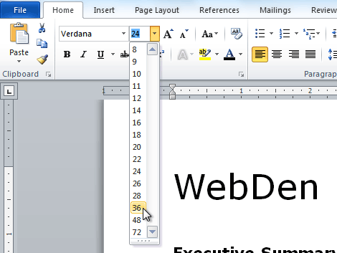
Formatting Text
Formatting text in Microsoft Word involves tasks like bolding the text, italicising it, and changing the font and size etc

Slide 3
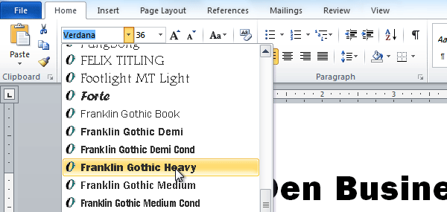
Change Font
word is used to make resume

Slide 4
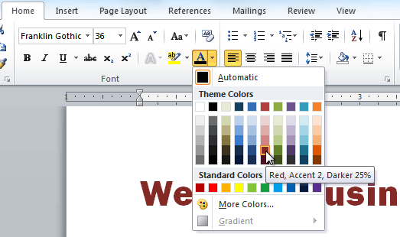
Change Font Color
Select the font color you want to use. The font color will change in the document

Slide 5
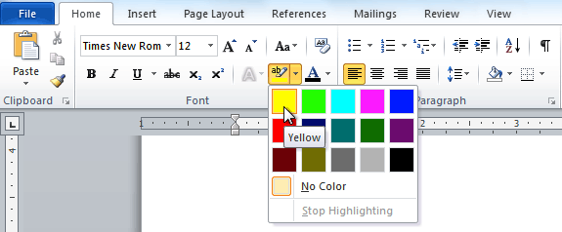
Highlight Text
Select the text you want to modify. It will then be highlighted

Slide 6
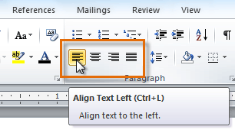
Highlight Text
Select one of the four alignment options from the Paragraph group on the Home tab to fix your desired alignment

Slide 7


